Slide 1

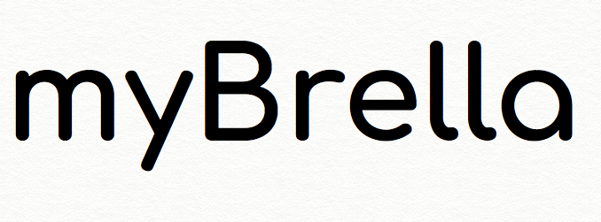
Created & Developed
by:
Justin Kunz
Mary Brown
Stephen Brown
Ingrid R Rowe

Slide 2
An Introduction to
myBrella is an application that allows the user to get weather data tailored to what they want. myBrella features make it easy for the user to get custom notifications and alerts that help you stay informed without having to check the app. For example, if the user wants to know if there will be rain on a particular day, they can set a specific time they wish to receive a weather alert for rain and prepare for it.

Slide 3
Introduction continued
Problems:
1. Never know when its raining until its too late
2. Weather notifications clutter my message inbox with traditional weather apps
3. I never receive the notifications on time
4. I can’t plan my day accordingly
Solutions
Allow user to customize the time they want notifications
Allow user to specify which weather notification they receive
Gives user flexibility to prepare for their day based on weather

Slide 4
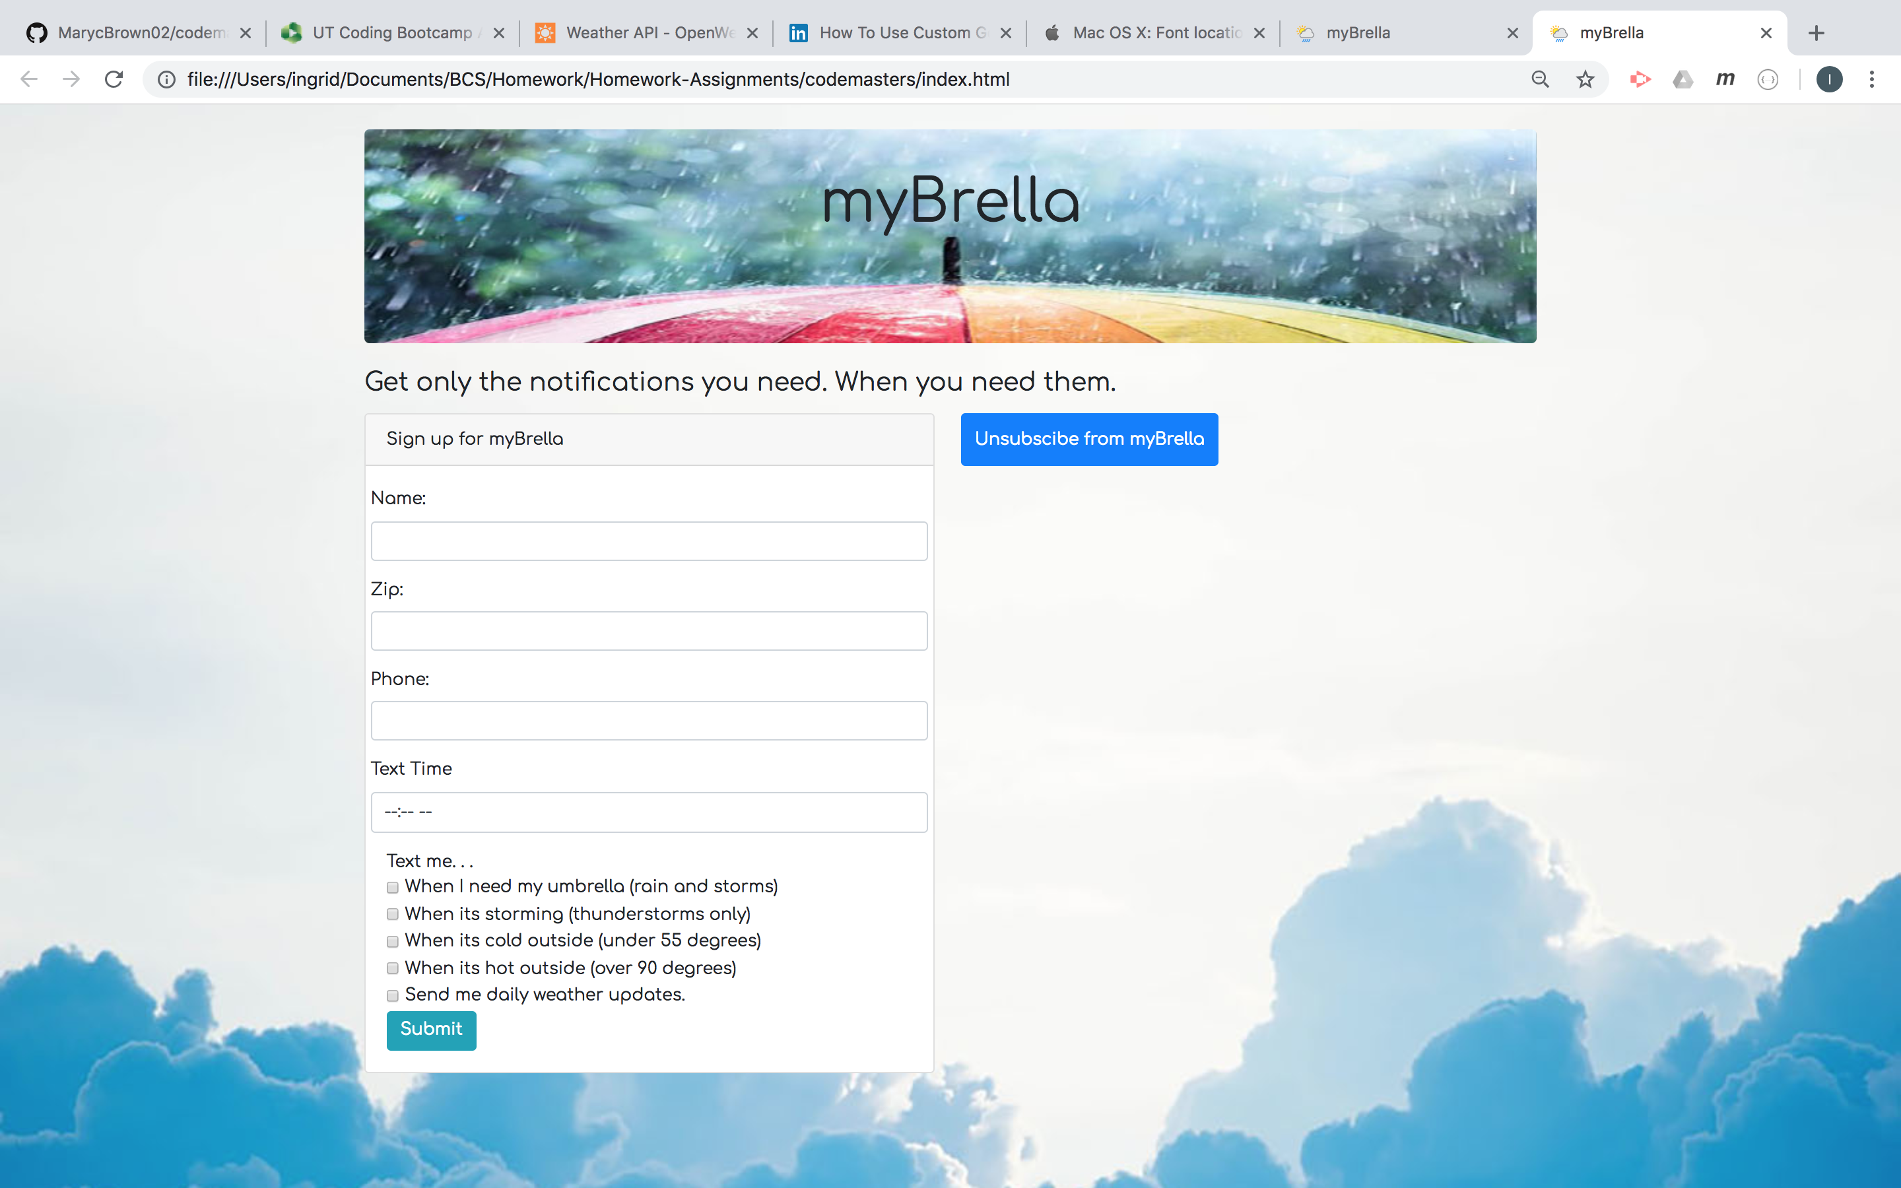

Slide 5
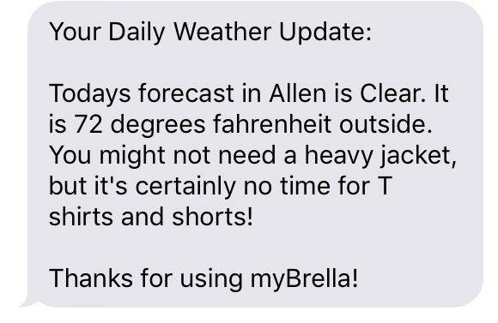
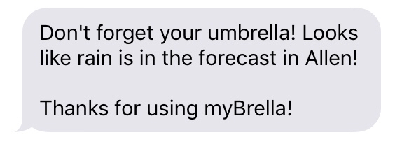
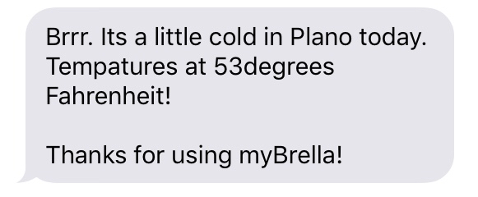
Push Notification Samples

Slide 6
Technologies Used
Bootstrap
Firebase
App Script
Html/CSS
Java script/Jquery
Open Weather API
Zip API
Twilio API

Slide 7
LIVE DEMO

Slide 8
Future Developments
Offer myBrella for free with certain in – app purchases.
Personalize your text messages to voice message tailored to their interests.
Users can set preferable weather for different activities (like jogging, hiking, cycling, nature photography, fishing etc.) and get a notification when conditions outside match their plans.
Interactive maps that show a difference in temperature, precipitation, clouds, wind speed and other conditions over the globe.

Slide 9
FINAL THOUGHTS and Q&A

